Slide 1

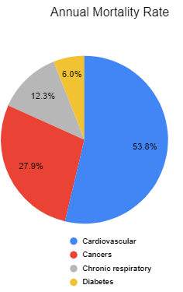

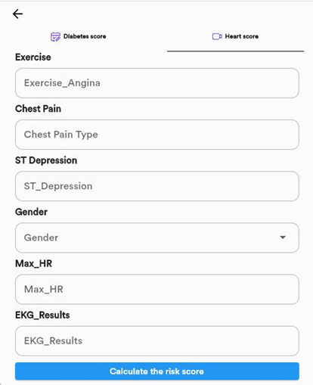
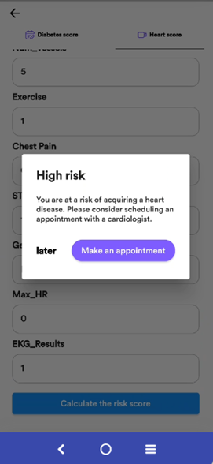
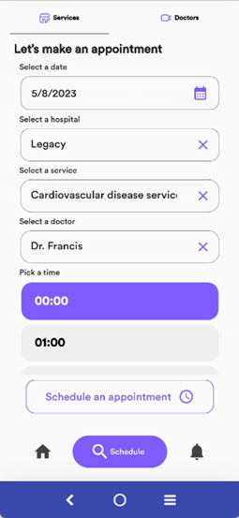
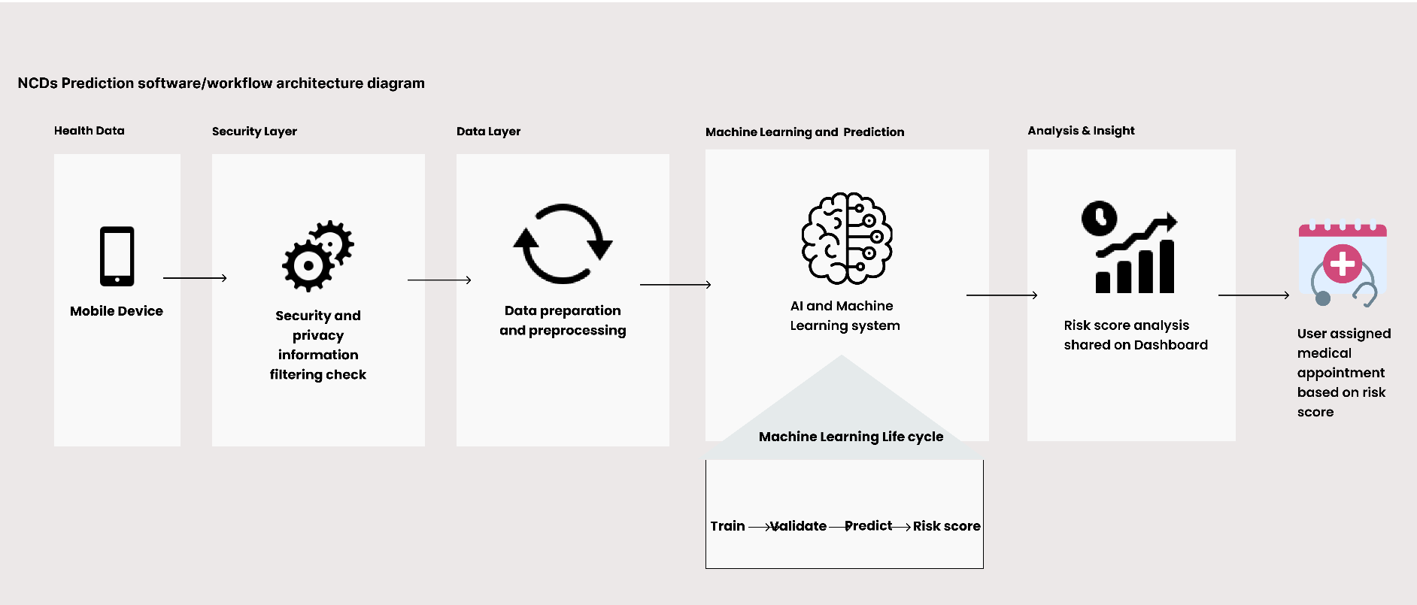

stroke,
AI-Based Mobile Platform for Predicting The risk of Having NCDs
AUTHORS: Ariane Shimirwa, Claudine Mahoro, Tyson Muvunyi
SUPERVISOR: Prof. Ahmed Biyabani
INTRODUCTION
RESULTS
Noncommunicable diseases (NCDs) also known
as chronic diseases, are long-lasting conditions
that develop slowly and are not caused by
infectious agents. They are becoming a global
public health concern due to the fatalities they
cause[1]
86% of these fatalities occur in low and middle
income countries and cardiovascular diseases
account for most NCD deaths with 17.9 million
people annually and diabetes accounts for 3 million[1]
Early detection, screening and treatment and
palliative care, are key components of the response
to NCDs[1]
A notable study by Knam et al., which utilized the Pima Indian Diabetes dataset, demonstrated the effectiveness of machine learning in medical diagnostics. They used machine learning models to diagnose diabetes, achieving an accuracy of 88.6% [2]. This highlighted the potential of machine learning techniques in medical predictions, laying the groundwork for integrating such models into user-friendly applications for health monitoring.
Support vector machine model demonstrated superior performance in predicting cardiovascular disease with an accuracy of 92.59% and the Artificial Neural Network model outperformed other models in predicting type 2 diabetes, achieving an accuracy of 92.15%. As a result, these two models, SVM and ANN, were saved and integrated into the mobile application. Figures 4, 5, 6, and 7 illustrate the user's journey within the application, starting from login, entering personal health information, and submitting it. If the app assesses the user as high-risk, it prompts them to schedule an appointment at their preferred hospital.
Fig 1: Annual Mortality rates
per disease
RESEARCH QUESTION
Figure 4: User Logging in
Figure 5: Interface for heart
disease risks prediction
How can advanced machine learning models be effectively utilized in mobile health applications to accurately predict the risk of noncommunicable diseases, thereby facilitating timely medical consultations?
METHODOLOGY
The methodology of this study included multiple phases: initially collecting and preprocessing cardiovascular and diabetes datasets, followed by detailed data analysis. Four machine learning models - Random Forest(RF), Support Vector Machine(SVM), Naïve Bayes(NB), and Artificial Neural Network(ANN) were employed, with their effectiveness measured through precision, recall, and F1 score.
Additionally, a mobile application was developed using Flutter, incorporating a Postgres database and Fast API for backend services. To ensure data privacy and security, robust security measures like authentication, encryption, and anonymization were integrated. This application allows users to input health metrics, which are then analyzed by the machine-learning algorithms to provide predictive results.
Assumptions
Target users are individuals not previously diagnosed with heart disease or type 2 diabetes and are interested in assessing their risk for these diseases
Users are informed about their health metrics and familiar with medical terminology
The platform is intended to complement clinical screening and diagnosis.
High-risk individuals identified by the platform are assumed to seek further medical consultations.
Figure 6: predictions of a user with high risk
Figure 7: scheduling an appointment
CONCLUSION & FUTURE WORK
All in all, this research developed a smartphone application for early detection of diabetes and cardiovascular diseases utilizing machine learning algorithms for predictions. Future work include:
Transitioning from online datasets to real clinical data to enhance model accuracy and improve platform reliability.
Exploring the possibility of using wearable sensors such as Continuous Glucose Monitoring devices and smartwatches to monitor relevant health metrics for data Collection.
Exploring additional machine learning techniques.
Expanding the disease spectrum covered by the app by adding more NCDs such as respiratory diseases, cancer, and stroke.
SELECTED REFERENCES
[1] “Non-communicable diseases,” World Health Organization, September 2022.
[2] J. J. Khanam and S. Y. Foo, “A comparison of machine learning algorithms for diabetes prediction,” ICT Express, vol. 7, no. 4, pp. 432–439, 2021
Figure 3: Solution architecture
Notes:
wljmfdlr

